Slide 1
AUTOENCODERS
Tara Hosseini

Slide 2
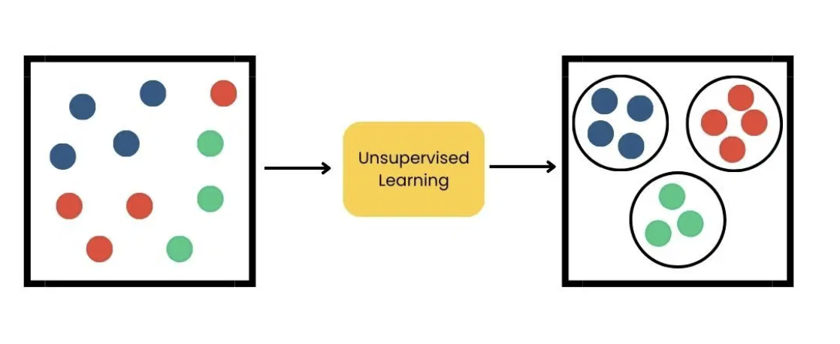
Unsupervised learning
Trains a model to learn intrinsic patterns, potential groupings, and correlations
Doesn't require labels for training

Slide 3
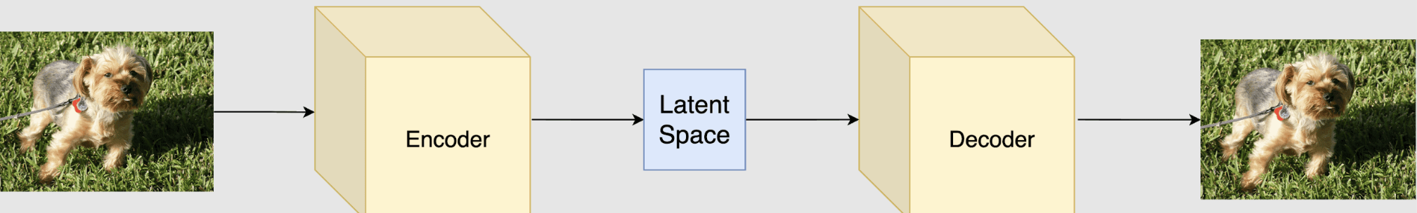
Autoencoders
A type of unsupervised/generative neural network designed to compress input data down to its essential features and then reconstruct the original input from the compressed representation
Made up of 3 essential components:
Encoder
Latent space or Bottle Neck
Decoder
Another Interpretation:
autoencoders are trained to discover latent variables of the input data: hidden or random variables that, despite not being directly observable, fundamentally inform the way data is distributed.
Notes:
imagine you had to summarize a book in one paragraph and then your friend had to recreate the full book from just your summary. If their recreation is terrible, your summary was bad and you need to do better. The reconstruction is essentially the test of whether the summary was any good.

Slide 4

Encoder
Receives the raw input data which can be image, text, or any other structured data
The encoder compresses the input data into smaller form through series of transformations
These transformations are called hidden layers, each with their own weights and activations to capture important patterns

Slide 5
Bottle neck (latent space)
The bottleneck is the smallest layer in the network that holds a compressed representation of the input data
forces model to only keep the most important features
Also referred to as the latent space

Slide 6
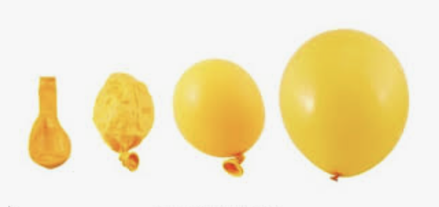
Decoder
the decoder is responsible for taking the compressed representation from the latent space and reconstructing it back to the original data form
It has hidden layers that expand the latent vector back to a higher dimensional space through successive transformations
the quality of this reconstruction depends on how well the encoder-decoder pair can minimize the difference between input and output during training

Slide 7
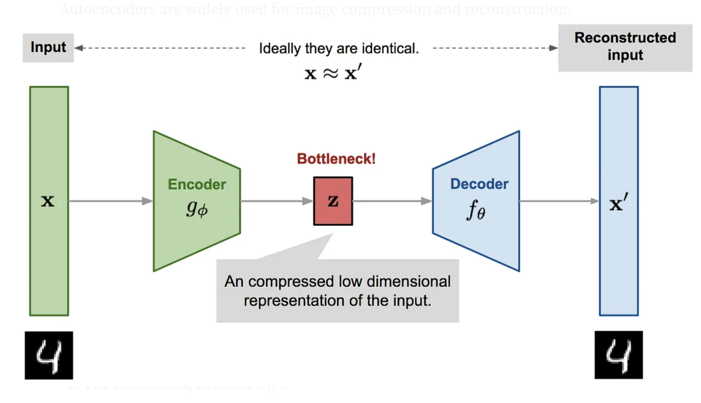
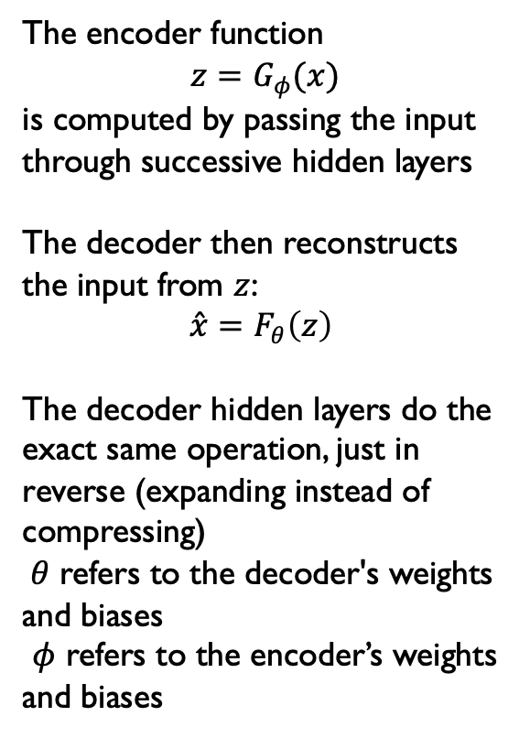

Math
The encoder function
$z=G_{φ}(x)$
is computed by passing the input through successive hidden layers
The decoder then reconstructs the input from $z$:
$$\overset{ˆ}{x}=F_{θ}\left(z\right)$$
The decoder hidden layers do the exact same operation, just in reverse (expanding instead of compressing)
$θ$ refers to the decoder's weights and biases
$φ$ refers to the encoder’s weights and biases
$$h^{\left(l\right)}=σ\left(W^{\left(l\right)}h^{\left(l−1\right)}+b^{\left(l\right)}\right)$$
Hidden Layers
Encoder
Decoder
$$z=G_{φ}(x)$$
$$\overset{ˆ}{x}=F_{θ}\left(z\right)$$
Notes:
An affine transformation scales and shifts the data; it multiplies the previous layer's output $h^{\left(l−1\right)}$by a learned weight matrix $W^{\left(l\right)}$and adds a bias vector $b^{\left(l\right)}$. The non-linear activation function $σ$, typically ReLu, is applied on top, allowing the network to capture complex non-linear patterns. The parameters $φ$refer collectively to all these learned weight matrices $W^{\left(l\right)}W^{\left(l\right)}b^{\left(l\right)}$

Slide 8
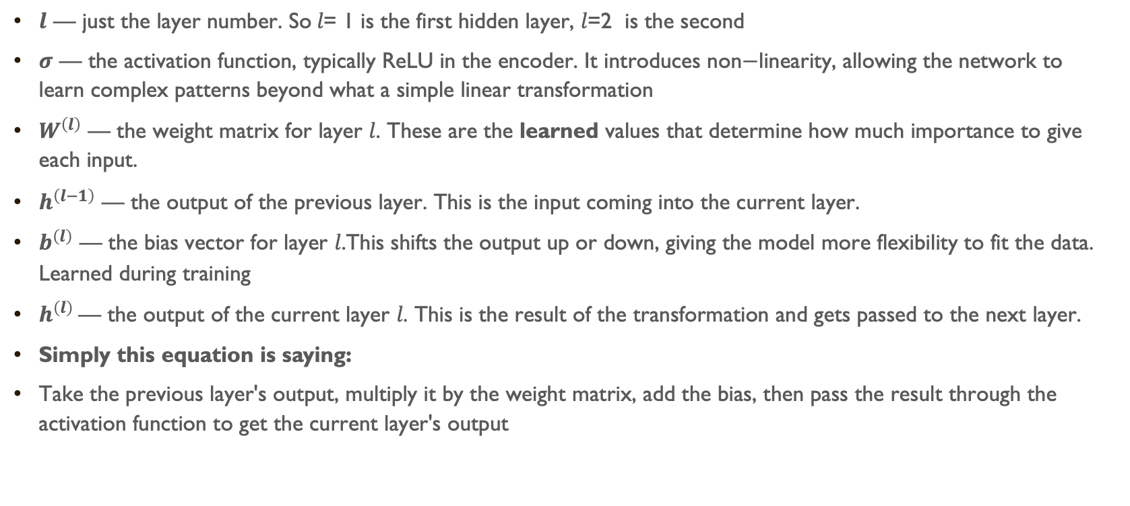
Math: Hidden Layer
$$h^{\left(l\right)}=σ\left(W^{\left(l\right)}h^{\left(l−1\right)}+b^{\left(l\right)}\right)$$
$l\text{ — }\text{just} \text{the} \text{layer} \text{number}\text{. }\text{So} l\text{= 1} \text{is} \text{the} \text{first} \text{hidden} \text{layer}\text{, }l\text{=2 } \text{is} \text{the} \text{second}$
$σ\text{ — }\text{the} \text{activation} \text{function}\text{, }\text{typically} \text{ReLU} \text{in} \text{the} \text{encoder}\text{. }\text{It} \text{introduces} \text{non}\text{−}\text{linearity}\text{, }\text{allowing} \text{the} \text{network} \text{to} \text{learn} \text{complex} \text{patterns} \text{beyond} \text{what} \text{a} \text{simple} \text{linear} \text{transformation}$
$W^{\left(l\right)}\text{ — }\text{the} \text{weight} \text{matrix} \text{for} \text{layer} l\text{. }\text{These} \text{are} \text{the} \text{learned} \text{values} \text{that} \text{determine} \text{how} \text{much} \text{importance} \text{to} \text{give} \text{each} \text{input}\text{. }$
$h^{\left(l−1\right)}\text{ — }\text{the} \text{output} \text{of} \text{the} \text{previous} \text{layer}\text{. }\text{This} \text{is} \text{the} \text{input} \text{coming} \text{into} \text{the} \text{current} \text{layer}\text{.}$
$b^{\left(l\right)}\text{ — }\text{the} \text{bias} \text{vector} \text{for} \text{layer} l\text{.}\text{This} \text{shifts} \text{the} \text{output} \text{up} \text{or} \text{down}\text{, }\text{giving} \text{the} \text{model} \text{more} \text{flexibility} \text{to} \text{fit} \text{the} \text{data}\text{. }\text{Learned} \text{during} \text{training}$
$h^{\left(l\right)} \text{— }\text{the} \text{output} \text{of} \text{the} \text{current} \text{layer} l\text{. }\text{This} \text{is} \text{the} \text{result} \text{of} \text{the} \text{transformation} \text{and} \text{gets} \text{passed} \text{to} \text{the} \text{next} \text{layer}\text{.}$
Simply this equation is saying:
$\text{Take} \text{the} \text{previous} \text{layer}\text{'}\text{s} \text{output}\text{, }\text{multiply} \text{it} \text{by} \text{the} \text{weight} \text{matrix}\text{, }\text{add} \text{the} \text{bias}\text{, }\text{then} \text{pass} \text{the} \text{result} \text{through} \text{the} \text{activation} \text{function} \text{to} \text{get} \text{the} \text{current} \text{layer}\text{'}\text{s} \text{output}$
Notes:
Affline transformation : it scales and shifts the data. a mathematical operation that multiplies the input by a weight matrix $W^{\left(l\right)}$and adds a bias vector $b^{\left(l\right)}$:
Weight and bias start at random values and get learned through back propagation and gradient descent

Slide 9

Training the autoencoder
During training, an autoencoder’s goal is to minimize the reconstruction loss, which measures how different the reconstructed output is from the original input
The choice of loss function depends on the type of data being processed
Mean Squared Error (MSE): Commonly used for continuous data. It measures the average squared differences between the input and the reconstructed data
Binary Cross-Entropy: Used for binary data (0 or 1 values). It calculates the difference in probability between the original and reconstructed output

Slide 10
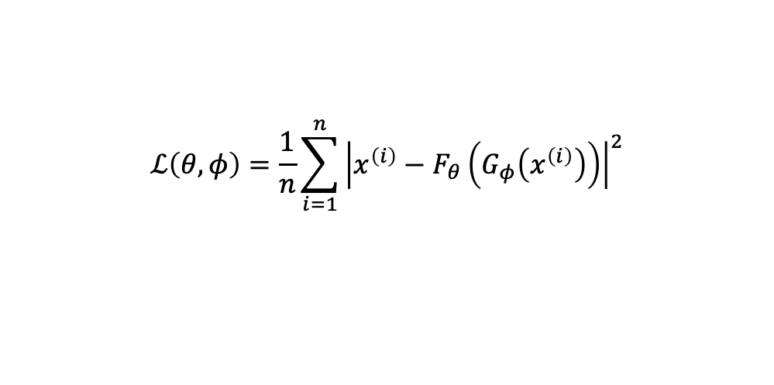
Mean Squared error Loss Function
$$ℒ\left(θ,φ\right)=\frac{1}{n}\sum_{i=1}^{n}{{\left|x^{\left(i\right)}−F_{θ}\left(G_{φ}\left(x^{\left(i\right)}\right)\right)\right|}^{2}}$$
It is minimized through backpropagation, where the error is passed backward through the network and used to update all weights via gradient descent
the encoder and decoder are trained jointly, the network simultaneously learns how to compress and how to reconstruct, improving both until the reconstruction loss is minimized.

Slide 11
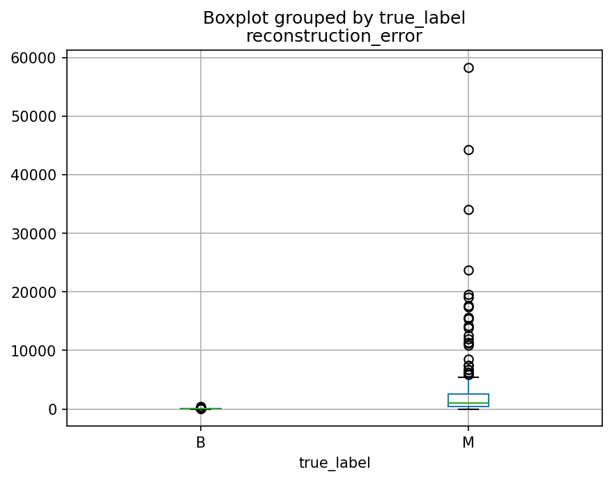
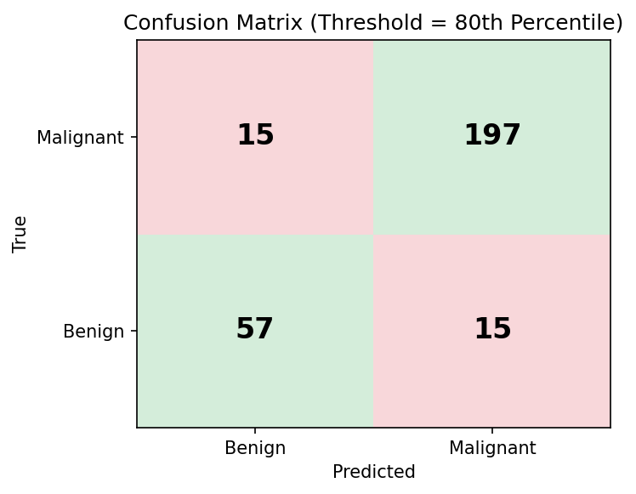
My project
Fine Needle Aspirate data from Breast Cancer Wisconsin (Diagnostic)
Samples either benign or malignant
30 features representative of different cellular nuclei characteristics
radius, texture, perimeter, area, smoothness, compactness, concavity
Trained autoencoder on benign samples only and tested on both benign and malignant samples
The rationale for this approach is that a model trained only on benign phenotypes will reconstruct benign samples well but struggle to reconstruct malignant samples, due to their differential cellular characteristics, resulting in a higher reconstruction error for malignant cases.
Sensitivity/Specificity Trade Off
Given the clinical context, minimizing false negatives (missed malignancies) was prioritized over minimizing false positives, as failing to detect a malignant tumor carries far greater risk

